Slide 1
UNIT-IV SYLLABUS Functions: Introduction – using functions – Function declaration/ prototype – Function definition – function call – return statement – Passing parameters – Scope of variables – Storage Classes – Recursive functions. Structure, Union, and Enumerated Data Types: Introduction – Nested Structures – Arrays of Structures – Structures and Functions– Union – Arrays of Unions Variables – Unions inside Structures – Enumerated Data Types.

Slide 2
REGISTER STORAGE CLASS-(register)
Storage : CPU Registers
Default initial value : Garbage value
Scope : Local to the block in which the variable is defined.
Life : Till the control remains within the block in which the variable is defined.
Note: The value stored in a CPU register can always be accessed faster than the one that is stored in memory.

Slide 3
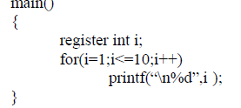
Example
Note: We cannot use register storage class for all types of variables. This is because the CPU registers in a microprocessor are usually 16 bit registers and therefore cannot hold a float or double or long value.

Slide 4
STATIC STORAGE CLASS-(static)
This storage class is used to declare static variables which are popularly used while writing programs in C language. Static variables have a property of preserving their value even after they are out of their scope! Hence, static variables preserve the value of their last use in their scope. So we can say that they are initialized only once and exist till the termination of the program.
Storage : Memory
Default initial value : zero
Scope : Local to the block in which the variable is defined.
Life : Value of the variable persists between different function calls.

Slide 5
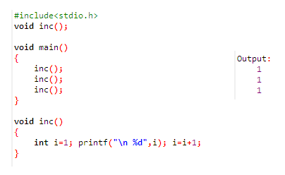
Example ( without static)

Slide 6
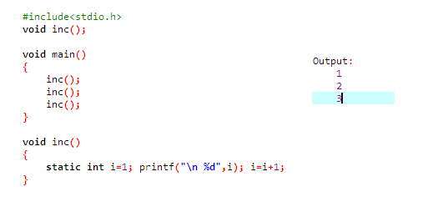
Example ( apply static )

Slide 7
EXTERNAL STORAGE CLASS-(extern)
Extern storage class simply tells us that the variable is defined elsewhere and not within the same block where it is used. Basically, the value is assigned to it in a different block and this can be overwritten/changed in a different block as well. So an extern variable is nothing but a global variable.
External variables are declared outside all functions, they are available to all functions that use extern variable.
Storage : Memory
Default initial value : Zero
Scope : Global
Life : As long as the program’s execution doesn’t come to an end.

Slide 8
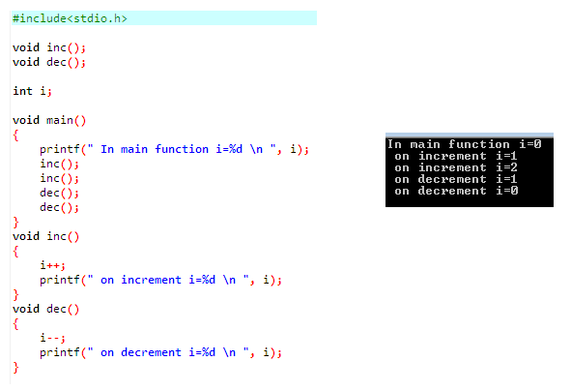
Example 1

Slide 9
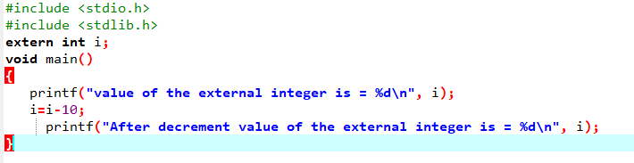

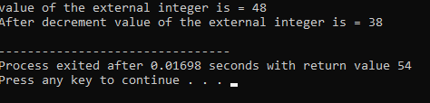
Example 2
Program 1
Program 2
Output :

Slide 10
